Slide 1




Data Analysis on Anime Recommendation System using MyAnimeList dataset
Pavan Sundar Reddy Guthikonda Padma Sai Paladugu Chandu Bodepudi

Slide 2


Table of Content
1
Introduction
2
Authors Contribution
3
Problem Statement
4
Objective
5
Proposed System
6
System Architecture
7
Plan of Action & recommendation system
Notes:
When conducting research, it is easy to go to one source: Wikipedia. However, you need to include a variety of sources in your research. Consider the following sources:
Who can I interview to get more information on the topic?
Is the topic current and will it be relevant to my audience?
What articles, blogs, and magazines may have something related to my topic?
Is there a YouTube video on the topic? If so, what is it about?
What images can I find related to the topic?

Slide 3
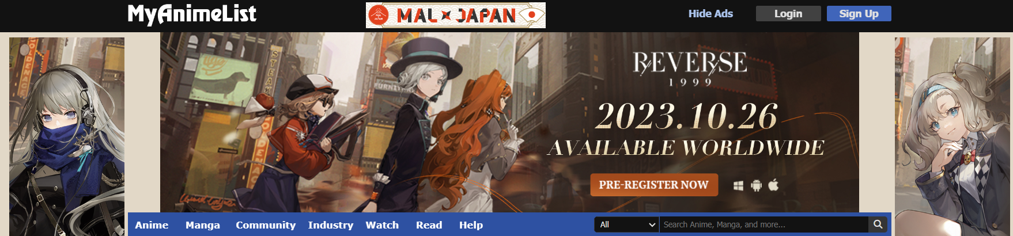



1
Introduction
Anime is a diverse and dynamic form of animated entertainment originating in Japan.
Nurtured by Japanese culture, anime is a captivating medium that seamlessly blends narrative innovation with diverse artistic expressions.
It has gained global popularity and continues to captivate viewers with its creativity and cultural significance.
MyAnimeList, often abbreviated as MAL, is a popular online platform and community-driven website dedicated to anime and manga enthusiasts.
Epic storytelling and emotional depth are hallmarks of anime.

Slide 4
2
Author’s Contribution & Phases
We as a team, collaboratively, worked on the project.
Phase -1
Brainstormed the existing methodologies and place of improvement area.
PHASE - 2
Data Preprocessing & Analysis of the dataset.
PHASE – 3
Get the prediction of the models & develop recommendation system.

Slide 5

3
Problem Statement
Due to the COVID-9 pandemic, there has been a significant increase in the demand for anime content, with more people turning to online entertainment.
However, the vast array of available anime presents a challenge for viewers seeking personalized recommendations.
To tackle this issue and enhance the anime streaming experience, our goal is to create an anime recommendation system that harnesses the power of big data concepts.

Slide 6

4
Objective
Create a recommendation system that offers personalized anime recommendations to each user based on their viewing history, ratings, and preferences.
To tackle this issue and enhance the anime streaming experience, our goal is to create an anime recommendation system that harnesses the power of big data concepts.

Slide 7

5
Proposed System
Ingest and store the data in HDFS for scalable and fault-tolerant storage.
Process the stored data using PySpark to clean, transform, and prepare the anime data. Handle missing values, remove duplicates, and standardize data formats.
Visualize the analyzed data using Tableau for creating interactive dashboards and visualizations to display recommendation results and user engagement metrics.
Analyze the processed data, by implementing collaborative filtering algorithms using PySpark’s machine-learning libraries.

Slide 8







6
System Architecture
Data Collection
Data Visualization
Recommendation
System
Data Storage
Data Pre-processing

Slide 9
6.1
Data Collection
Obtained required data from the Kaggle dataset.
Dataset size: ~6800MB
Dataset timeline: Based on 2020 & latest data
Type of dataset: Structured data in CSV format.
Data Collection

Slide 10

6.2
Data Storage
Data Storage
In order to save the storage, used parquet instead of csv format
Stored all the data which is in .parquet format into Hadoop (hdfs)

Slide 11


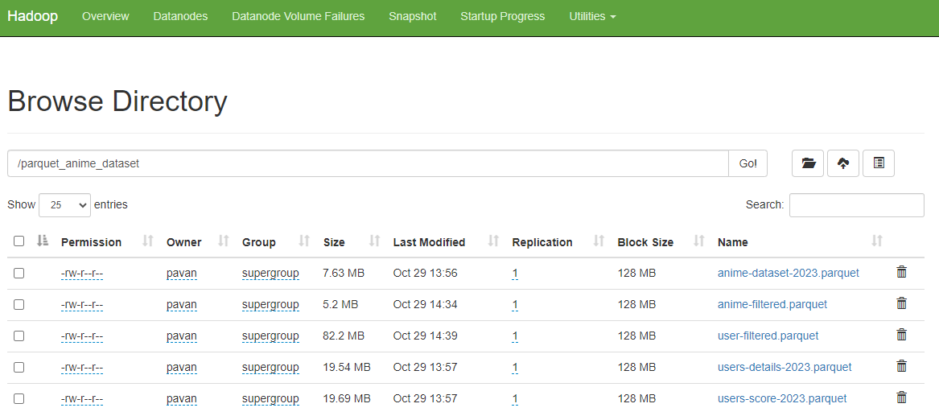
6.2
Data Storage
CSV Format
PARQUET Format
HDFS DATA
INSERTION

Slide 12
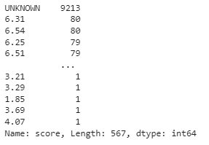
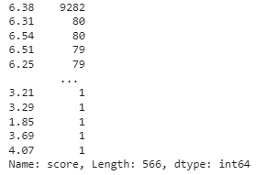
6.3
Data Preprocessing
In the data there some noisy data which has been taken care like below.
Data Pre-processing
Here, score column has some UNKNOWN value present in the dataset, which has been pre-processed by using mean method.

Slide 13
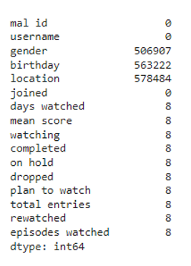
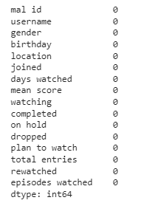
6.3
Data Preprocessing

Slide 14
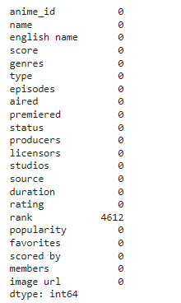
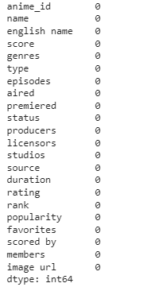
6.3
Data Preprocessing

Slide 15
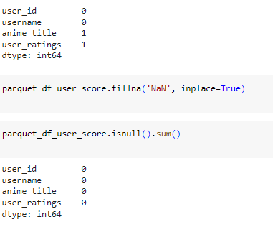
6.3
Data Preprocessing

Slide 16
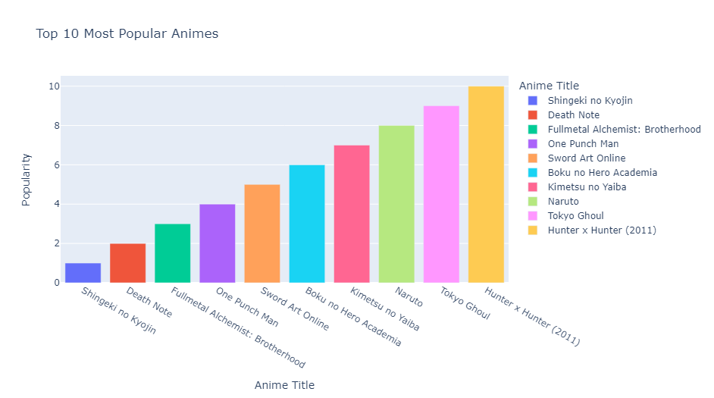
6.4
Data Visualization

Slide 17
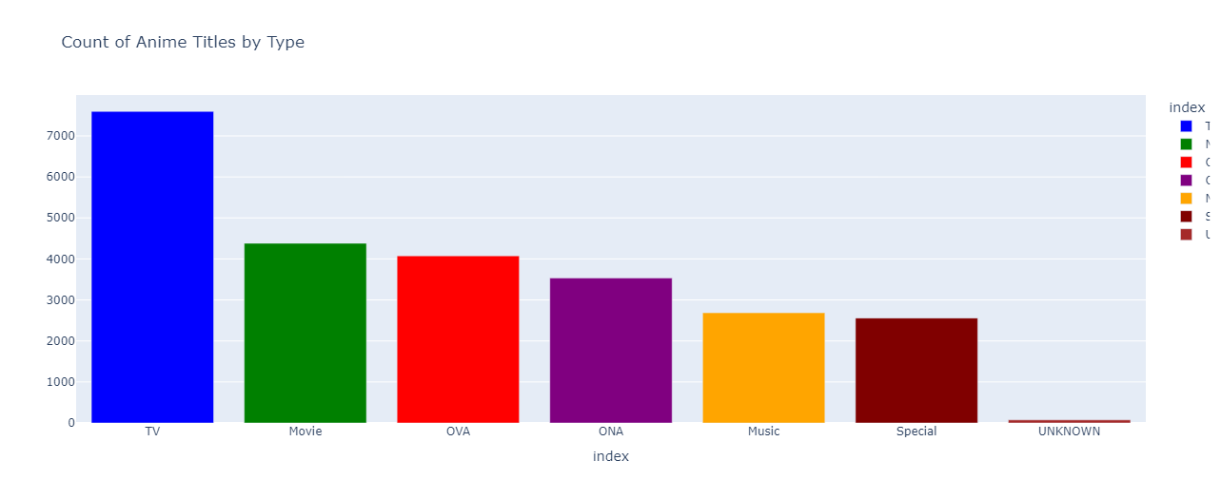
6.4
Data Visualization

Slide 18
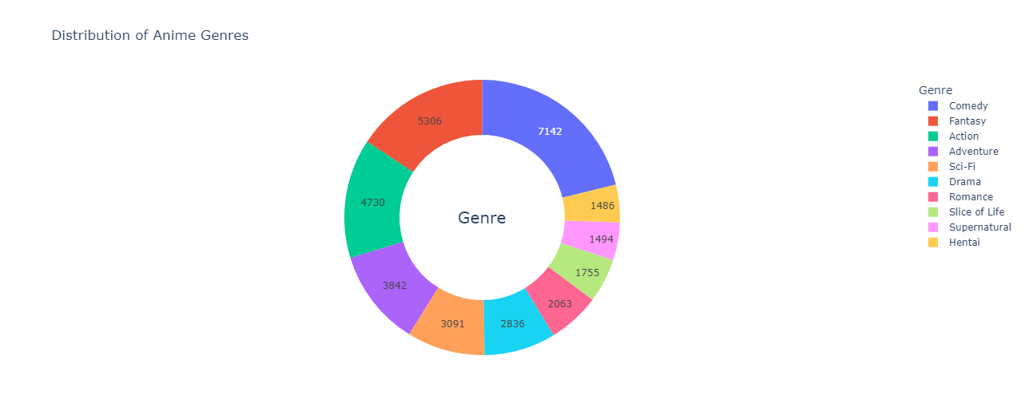
6.4
Data Visualization

Slide 19
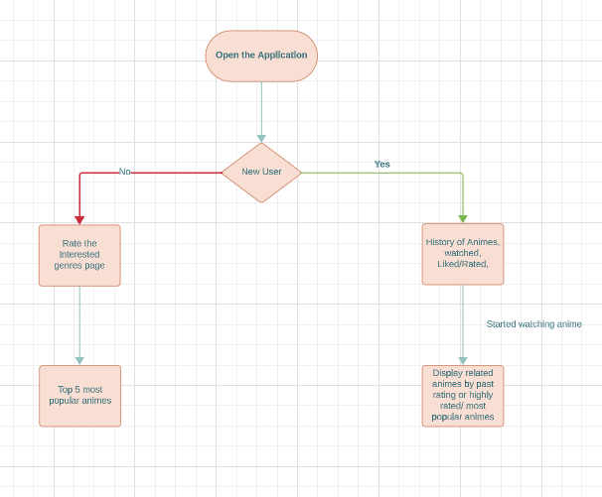
6.5
7
Plan of Action & recommendation system

Slide 20
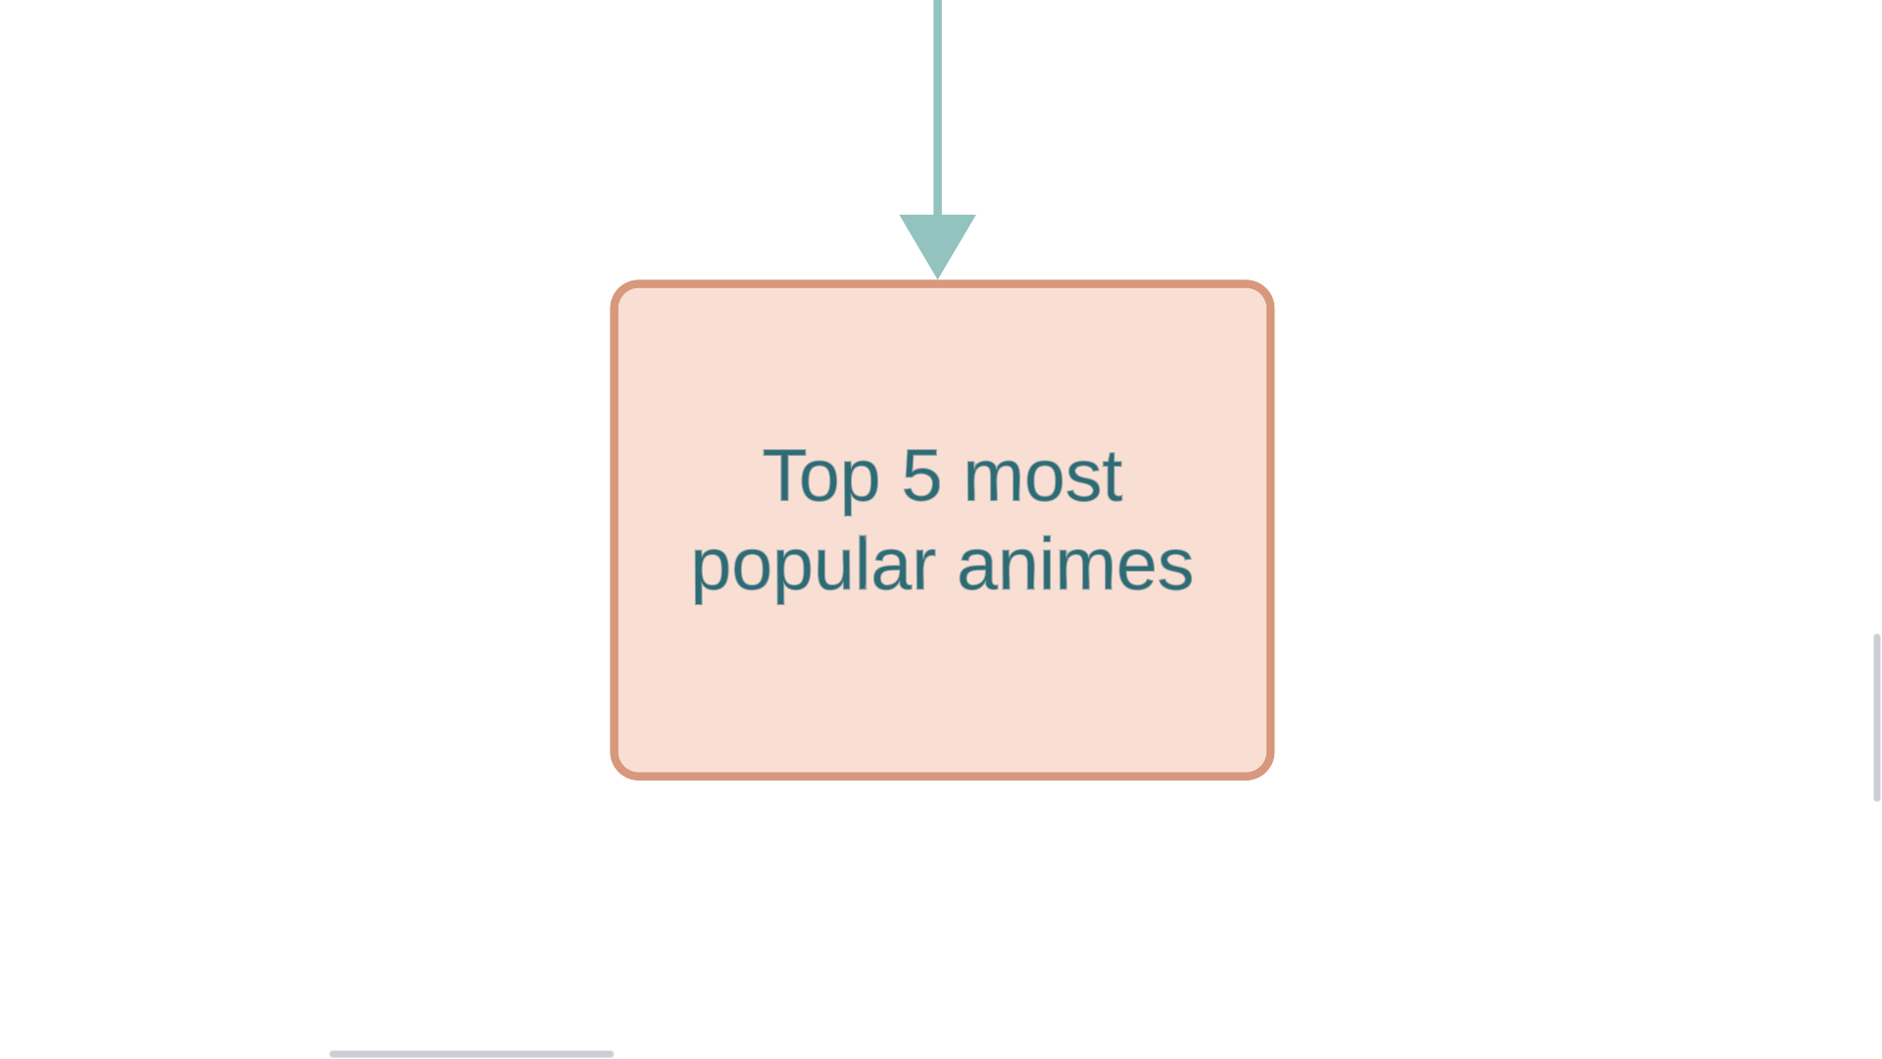
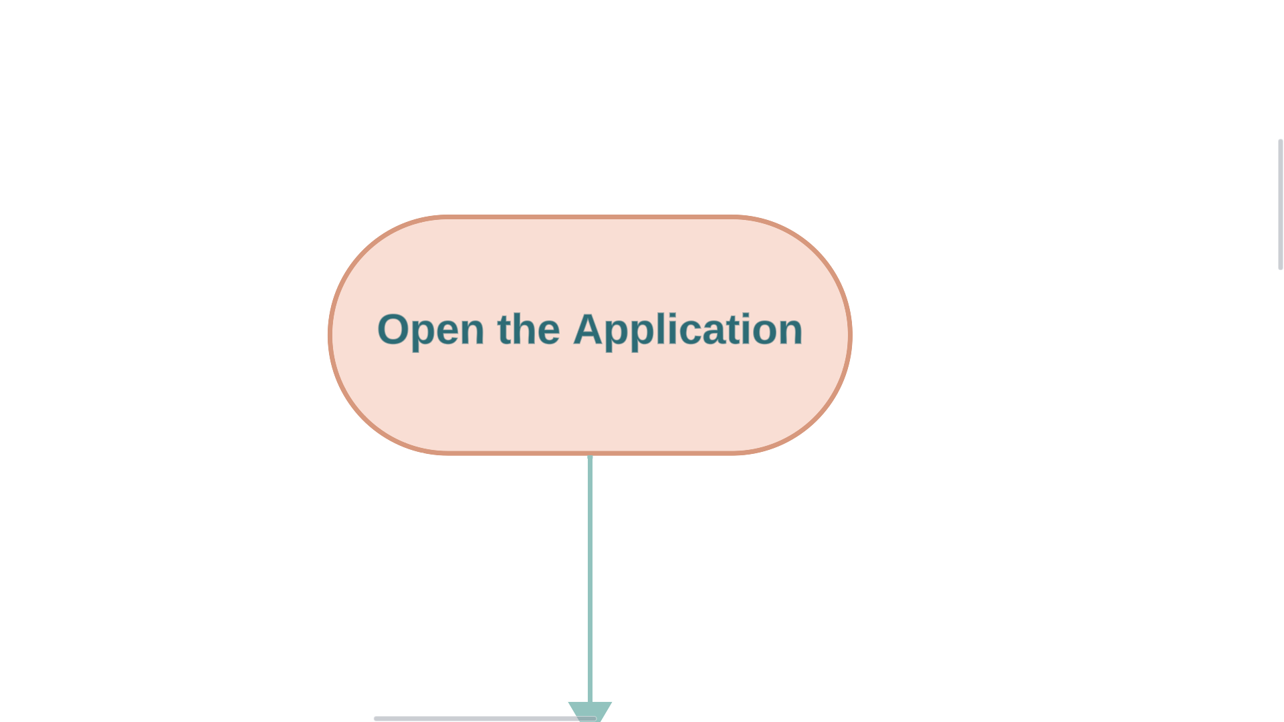

Slide 21
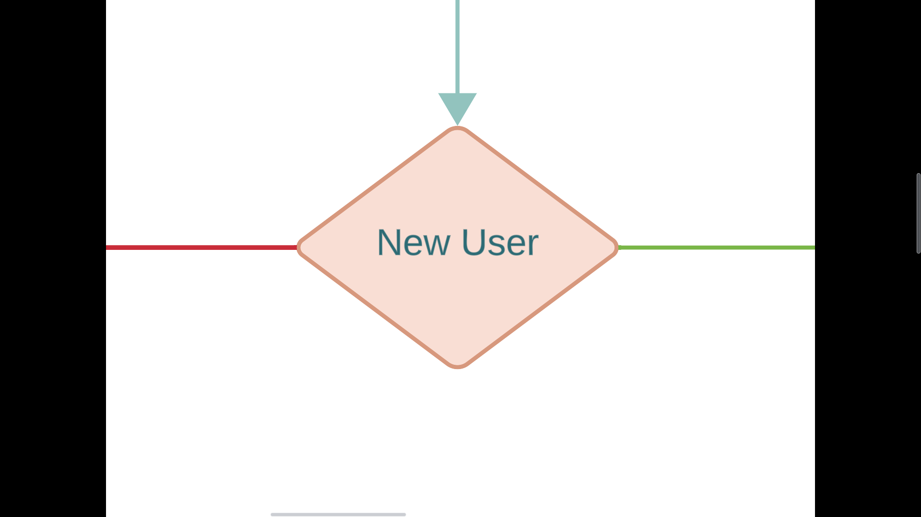

Slide 22
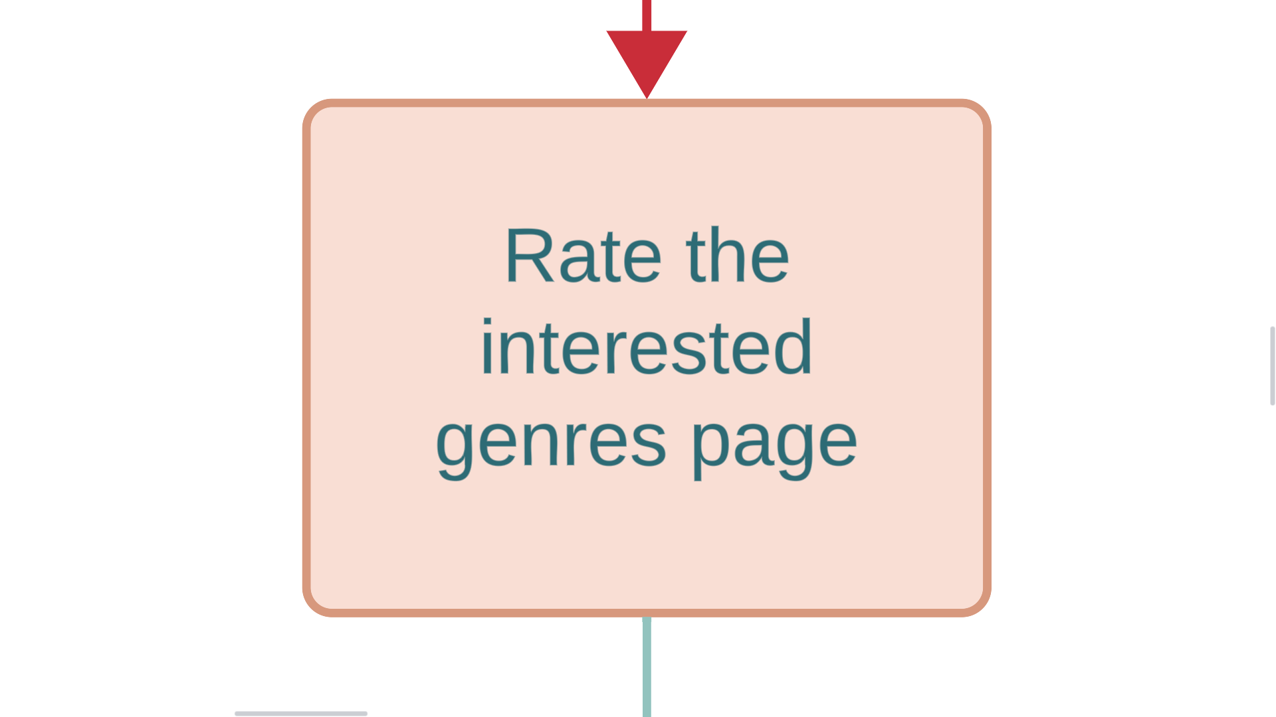
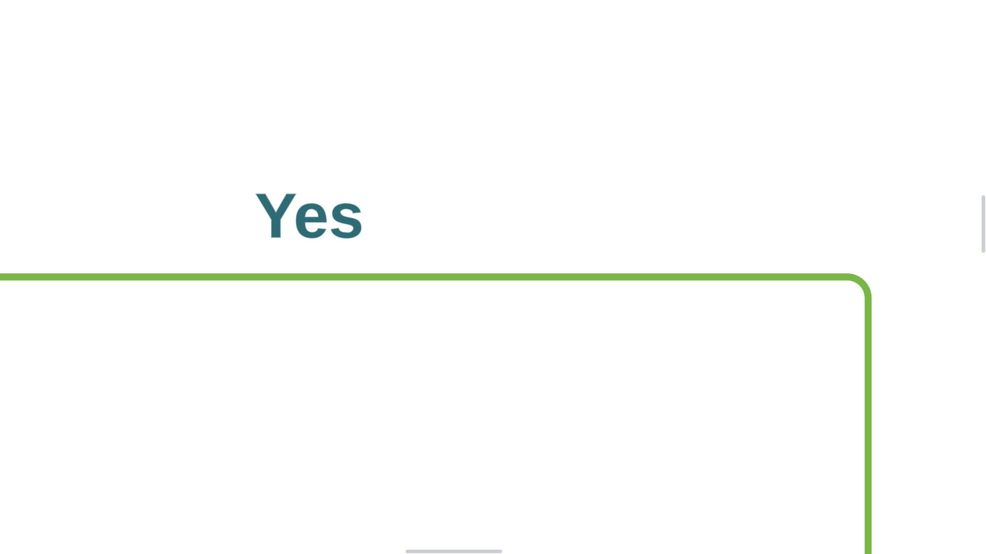

Slide 23
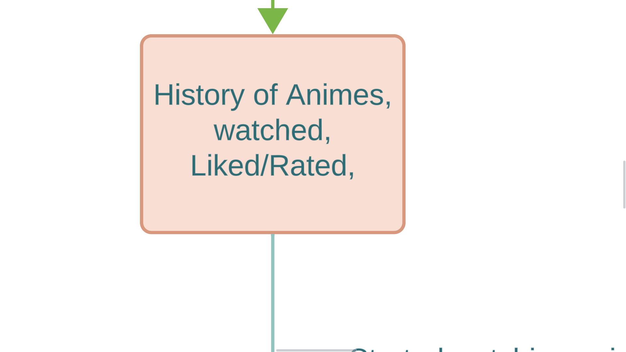

Slide 24
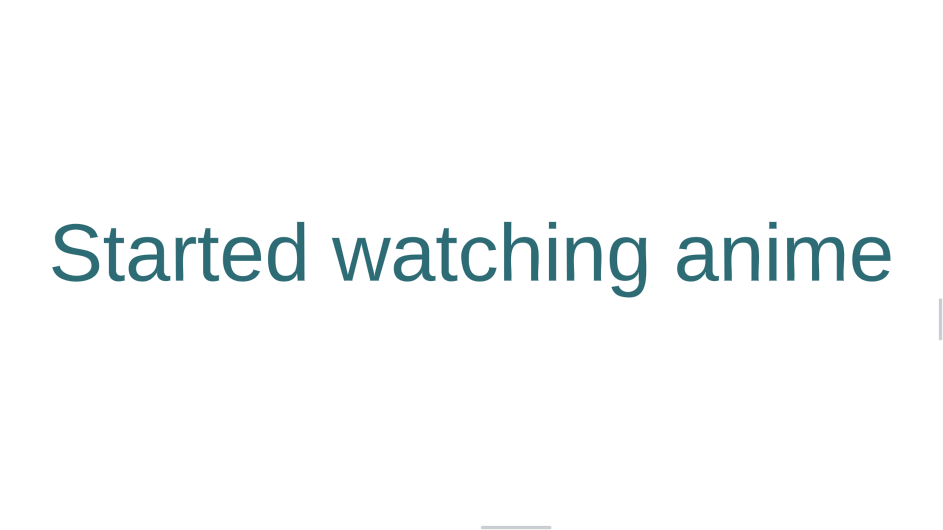

Slide 25
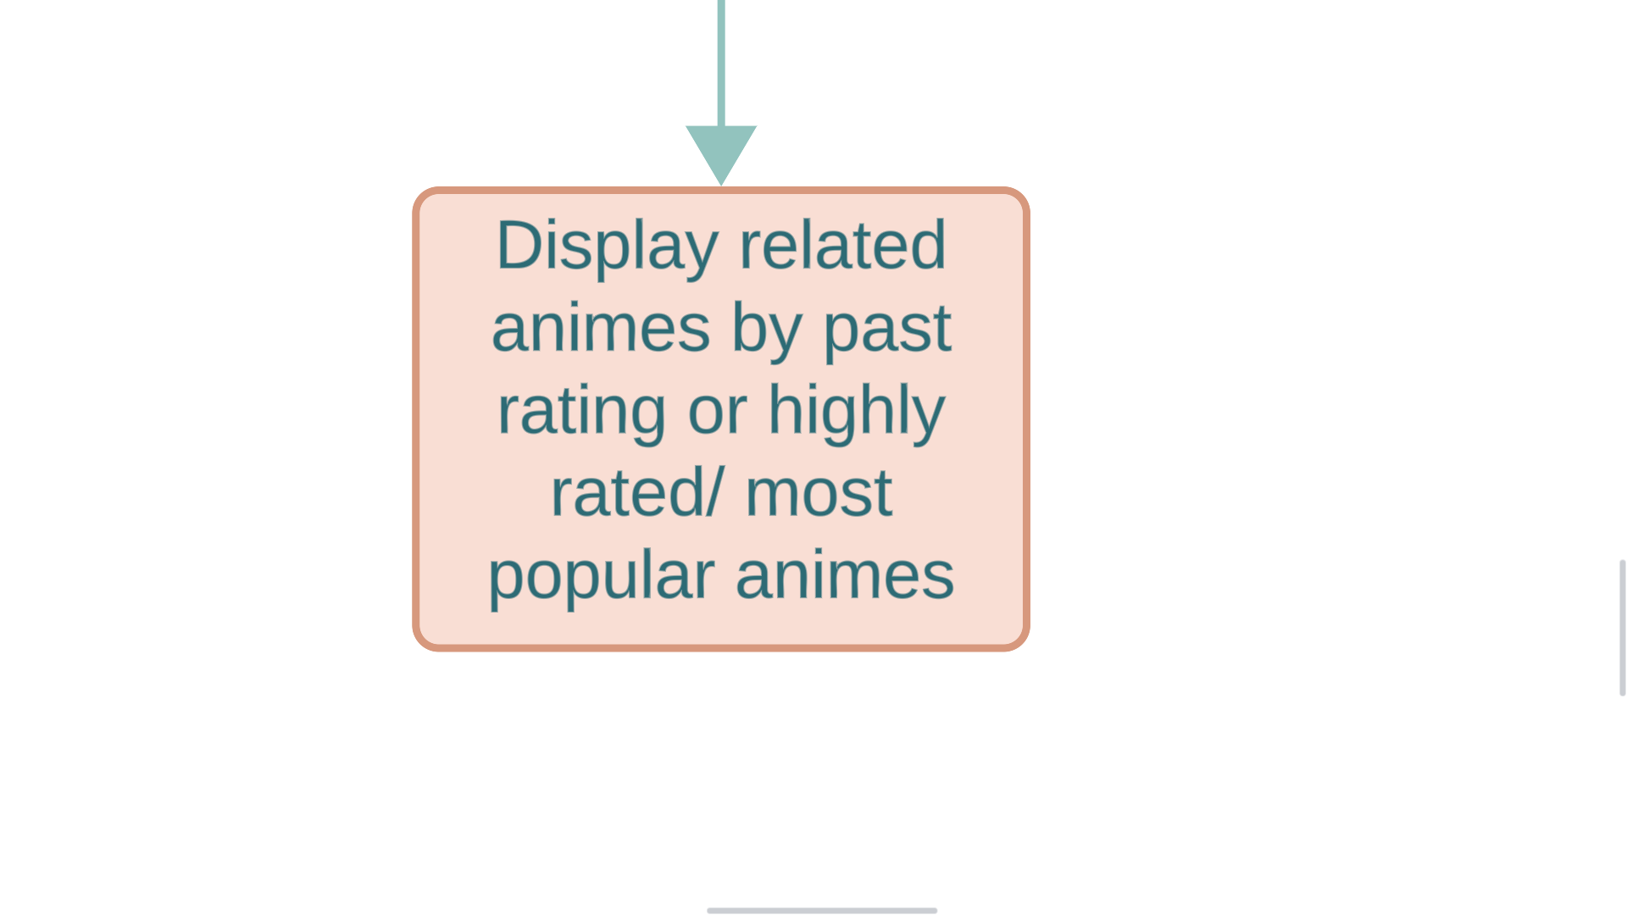

Slide 26
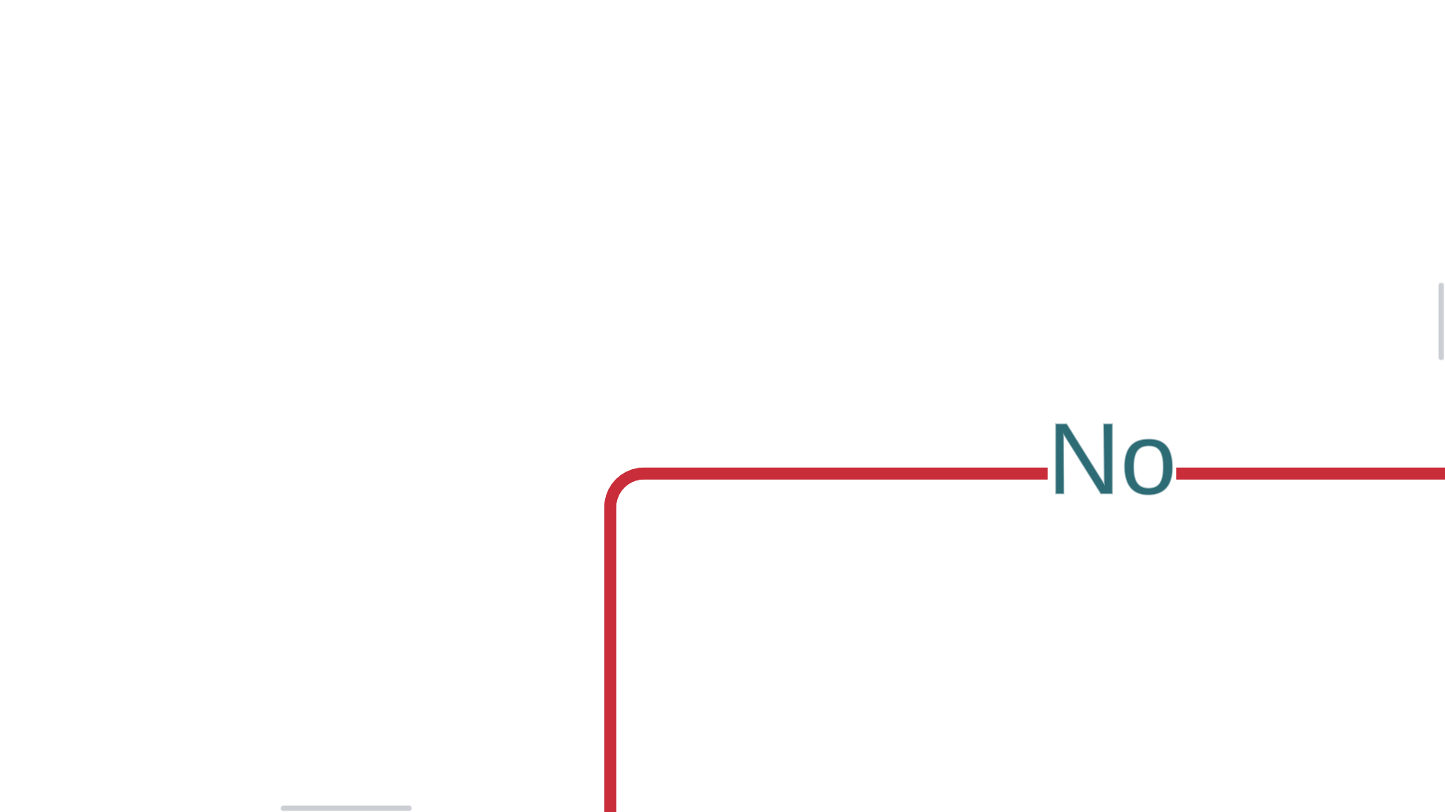

Slide 29


